Slide 1
An Efficient Algorithm for Enumerating Longest Common Increasing Subsequences
Chun Lin, Chao-Yuan Huang, Ming-Jer Tsai
International Computing and Combinatorics Conference 2021: Computing and Combinatorics pp 25–36
Presenter: Guan-Jie Chen
Date: Apr. 18, 2023

Slide 2
Abstract (1 / 2)
The longest common increasing subsequence (LCIS) problem is the combination of two classic problems in algorithms: the longest increasing subsequence (LIS) problem and the longest common subsequence (LCS) problem. In this paper, we propose an algorithm that finds every LCIS of two sequences a, b of length n in O(n + σ + I_{a}) time and space, where σ denotes the size of the alphabet set and I_{a} the total number of increasing subsequences contained in a (thus, the running time is output-sensitive).

Slide 3
Abstract (2 / 2)
Our algorithm employs the trie and some simple data structures, and thus is implementation-wise simple. In addition, it can be proved that our algorithm is optimal in time complexity when σ ≤ log₂ n.

Slide 4
Purpose
Finding longest common increasing subsequence between A & B
A = [1, 4, 1, 0, 3] B = [1, 4, 3, 1, 3]

Slide 5
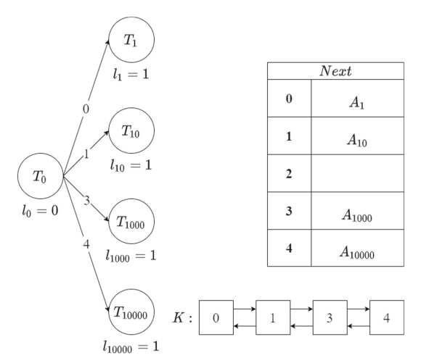
Longest Increasing Subsequence of A (1 / 7) (Initialization)
A = [1, 4, 1, 0, 3]
Cnt
0 | 1
1 | 2
2 | 0
3 | 1
4 | 1
Notes:
T2i用二進位表示，即1後面接幾個0
根據Cnt用double linked list建K
l是長度
Next紀錄指向node的address

Slide 6
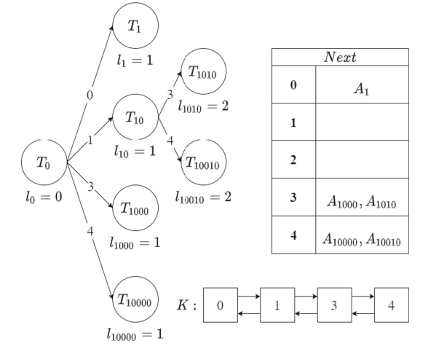
Longest Increasing Subsequence of A (2 / 7)
A = [1, 4, 1, 0, 3]
Cnt
0 | 1
1 | 1
2 | 0
3 | 1
4 | 1
Notes:
因為A[1] = 1, Next[1] (A₁₀)被pop掉
查K，找可以接在後面的，push進Next裡面

Slide 7
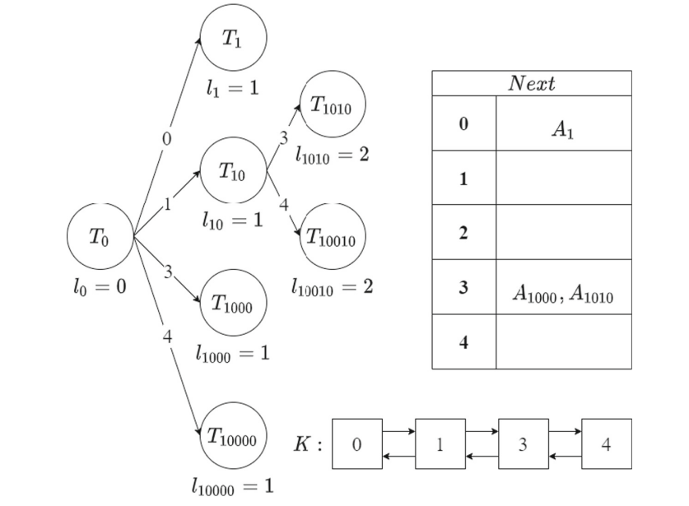
Longest Increasing Subsequence of A (3 / 7)
A = [1, 4, 1, 0, 3]
Cnt
0 | 1
1 | 1
2 | 0
3 | 1
4 | 0

Slide 8
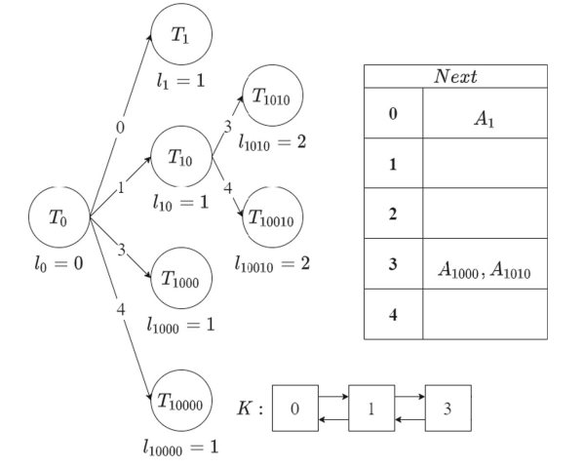
Longest Increasing Subsequence of A (4 / 7)
A = [1, 4, 1, 0, 3]
Cnt
0 | 1
1 | 0
2 | 0
3 | 1
4 | 0

Slide 9
Longest Increasing Subsequence of A (5 / 7)
T₁₀₀₁
A = [1, 4, 1, 0, 3]
3
l₁₀₀₁ = 2
Cnt
0 | 0
1 | 0
2 | 0
3 | 1
4 | 0
, A₁₀₀₁

Slide 10
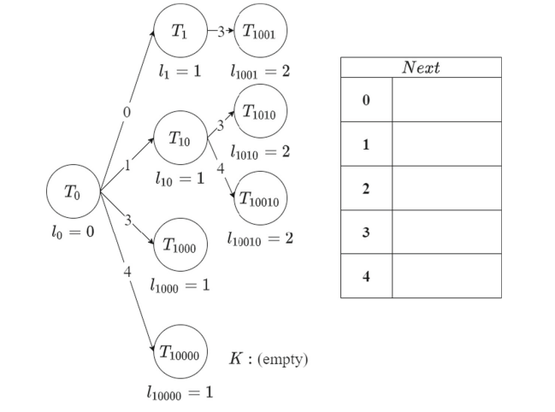
Longest Increasing Subsequence of A (6 / 7)
A = [1, 4, 1, 0, 3]
Cnt
0 | 0
1 | 0
2 | 0
3 | 0
4 | 0
3

Slide 11
Longest Increasing Subsequence of A (7 / 7)
A = [1, 4, 1, 0, 3]
Cnt
0 | 0
1 | 0
2 | 0
3 | 0
4 | 0

Slide 12
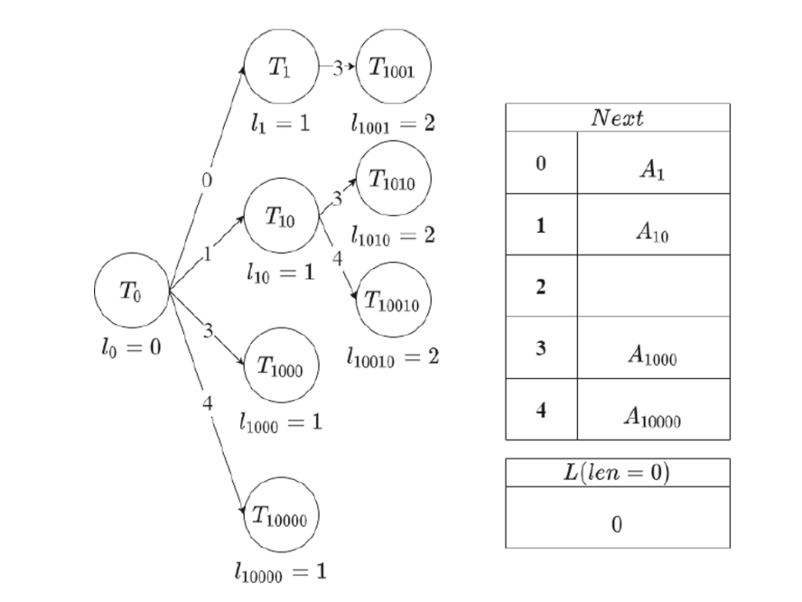
Longest Common Increasing Subsequence (1 / 3)
B = [1, 4, 3, 1, 3]

Slide 13
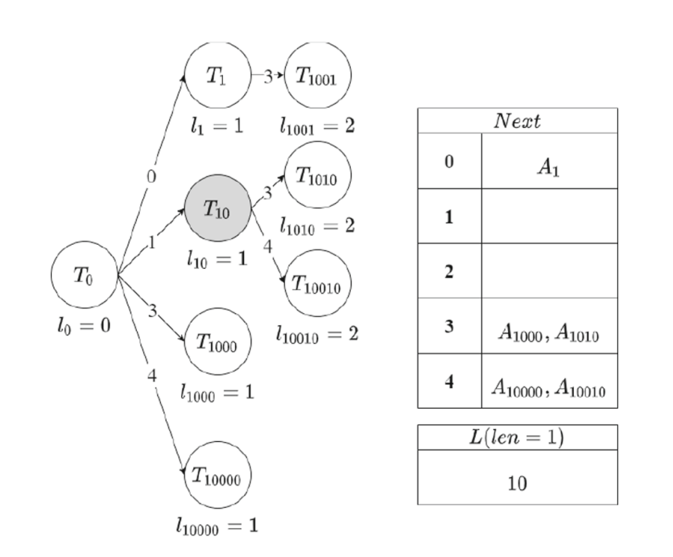
Longest Common Increasing Subsequence (2 / 3)
B = [1, 4, 3, 1, 3]

Slide 14
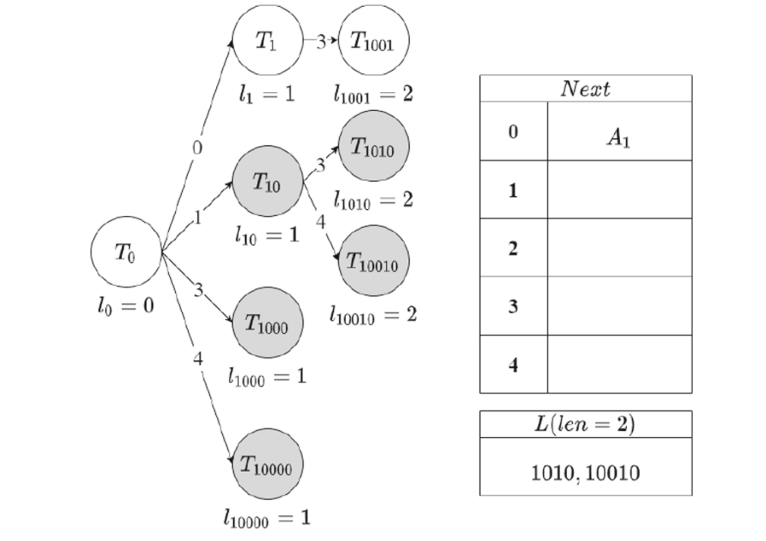
Longest Common Increasing Subsequence (3 / 3)
B = [1, 4, 3, 1, 3]

Slide 15
Time Complexity
O(n + σ + I_{a})
initialization: O(n + σ)
σ: the size of the alphabet set
I_{a}: the total number of increasing subsequences contained in A
I_{a} ≤ 2^{σ}

Slide 16
Thanks for your patience

